Slide 1



Prediction of Clinical Risk Factors of Diabetes Using Multiple Machine Learning Techniques
PRESENTED BY:
NAME: TAMANNA
COURSE NAME:DATA SCIENCE WITH PYTHON
BATCH:DS-02
DEPARTMENT: BIOCHEMISTRY & BIOTECHNOLOGY

Slide 2

Overview
1.
2.
3.
4.
Abstract
Introduction
Motivations
Objectives
5.
6.
7.
8.
Methodology
Result
Conclusion
Reference

Slide 3


Background
Diabetes, often termed a "silent killer," is a rapidly increasing global health issue that significantly affects life expectancy and leads to severe complications, including cardiovascular disease and kidney failure. The rising prevalence, particularly among older adults, highlights the critical need for early diagnosis and intervention. This study focuses on analyzing key risk factors for diabetes using clinical data and employs machine learning techniques to improve predictive accuracy. By identifying significant predictors such as glucose levels, BMI, and age, the research aims to enhance diabetes management and prevention strategies.
.

Slide 4
Abstract
Diabetes is a significant global health issue that reduces life expectancy and is associated with severe complications. Early diagnosis is essential for effective management. This research examined diabetes risk factors using clinical data, including glucose levels, BMI, blood pressure, and age, and utilized Logistic Regression and Random Forest for prediction. Key preprocessing steps addressed invalid values, feature scaling, and class imbalance. The analysis identified glucose levels, BMI, and age as the primary predictors, with Random Forest achieving 83% accuracy, surpassing Logistic Regression's 78%. These findings highlight the effectiveness of machine learning in facilitating early diabetes diagnosis and enhancing patient care.
.

Slide 5
Introduction
Diabetes affects 465 million adults globally, expected to rise to 700 million by 2045.
Leads to severe complications like heart disease, kidney failure, and nerve damage.
Early diagnosis is vital to prevent severe outcomes.
Machine learning offers innovative tools for analyzing complex clinical data.
This study aims to combine machine learning techniques to predict diabetes risk factors
.

Slide 6
Research Motivations
Diabetes prevalence is rising due to lifestyle changes and aging populations.
Traditional diagnosis methods are invasive, slow, and expensive.
Early identification of at-risk individuals can prevent complications.
Machine learning provides non-invasive, cost-effective predictive models.
This study compares Logistic Regression and Random Forest to determine the best-performing model.
.

Slide 7
Literature Review
Logistic Regression identifies key predictors like glucose, BMI, and age.
Random Forest excels in handling complex relationships with higher accuracy.
Class imbalance is addressed using SMOTE and class weighting techniques.
Preprocessing steps like outlier handling and feature scaling improve model performance.
Studies show a trade-off between Logistic Regression’s interpretability and Random Forest’s accuracy.
.

Slide 8
Objectives
Develop accurate diabetes risk prediction models.
Identify significant clinical risk factors.
Support early detection and prevention strategies.
Enhance healthcare efficiency and promote non-invasive assessment.
.

Slide 9
Dataset Description
Dataset: 768 entries with 9 attributes (e.g., glucose, BMI, age, etc.)
Target Variable: Diabetes outcome (1 = diabetic, 0 = non-diabetic).
Preprocessing:
Replaced invalid values (zeros) with means.
Standardized numerical features.
Addressed class imbalance using class weighting.
.

Slide 10
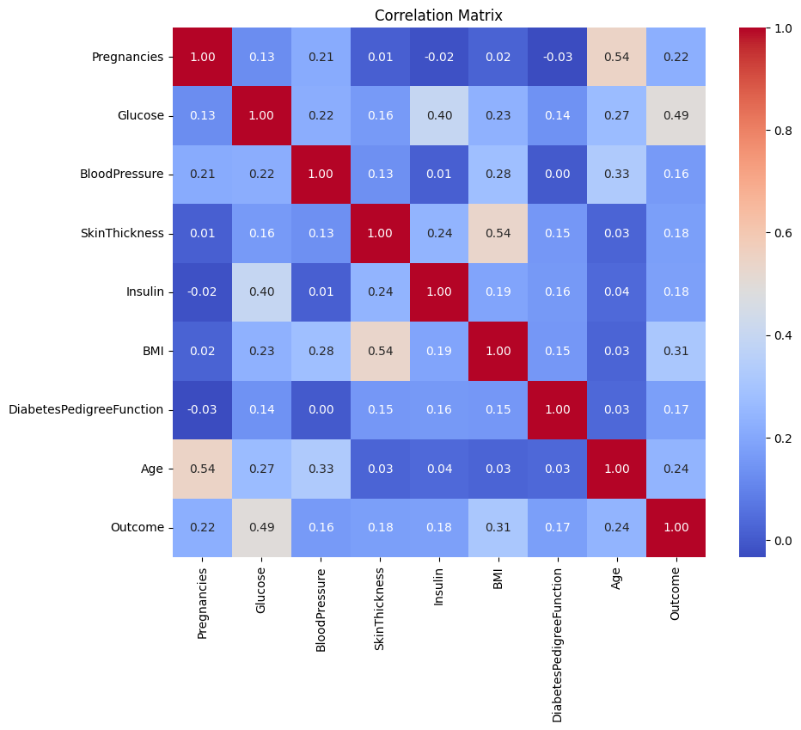
Methodology
Data Preprocessing:
Outlier Handling: Used IQR method.
Feature Scaling: Standardized all features.
Model Development:
Logistic Regression for interpretability.
Random Forest for complex patterns and feature importance.
Model Evaluation:
Metrics: Accuracy, Precision, Recall, F1-score.
.
Fig. 2: Correlation Matrix identify relationships between features and the target variable .

Slide 11
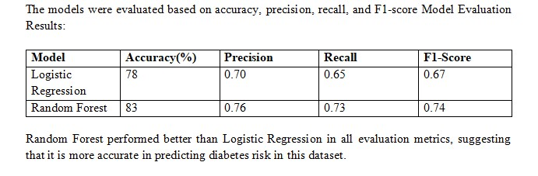
Result
Statistical Analysis:
Strongest predictors: Glucose (0.49), BMI (0.31), Age (0.21).
Weak predictors: Insulin, Skin Thickness, Pregnancies.
Model Results:
Random Forest: 83% accuracy.
Logistic Regression: 78% accuracy.
.

Slide 12
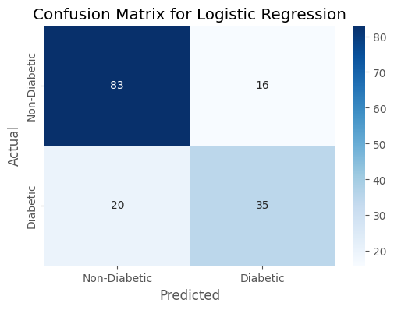
Result Visualization
Feature Importance (Random Forest):Glucose (32%), BMI (22%), Age (18%).
Confusion Matrix: Show model performance with TP, TN, FP, FN.
Comparison of Metrics: Random Forest outperforms Logistic Regression in all metrics.
.
Fig. 3: Confusion Matrix for Logistic Regression

Slide 13
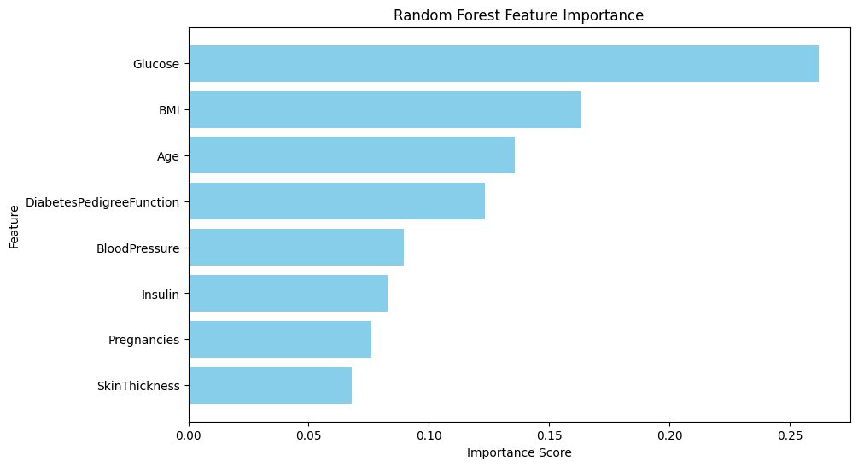
.
Fig. 4: Random Forest Feature Importance Identification

Slide 14
Discussion
Glucose, BMI, and Age are consistent top predictors.
Random Forest offers higher accuracy, while Logistic Regression provides interpretability.
Results align with established clinical research, reinforcing the significance of the identified predictors.

Slide 15

Thank You

